Slide 1
Regex dialects
ML-Lex and others

Slide 2
Ml-Lex
http://www.smlnj.org/doc/ML-Lex/manual.html
An individual character stands for itself, except for the reserved characters
? * + | ( ) ^ $ / ; . = < > [ { " \
A backslash followed by one of the reserved characters stands for that character.

Slide 3
A set of characters enclosed in square brackets [ ] stands for any one of those characters.
Inside the brackets, only the three symbols \ - ^ are reserved. An initial up-arrow ^ stands for the complement of the characters listed, e.g. [^abc] stands any character except a, b, or c.
The hyphen - denotes a range of characters, e.g. [a-z] stands for any lower-case alphabetic character, and [0-9a-fA-F] stands for any hexadecimal digit.
To include ^ literally in a bracketed set, put it anywhere but first; to include - literally in a set, put it first or last.

Slide 4
The dot . character stands for any character except newline, i.e. the same as [^\n]
The following special escape sequences are available, inside or outside of square-brackets:
\b backspace
\n newline
\t tab
A sequence of characters will stand for itself (reserved characters will be taken literally) if it is enclosed in double quotes " ".
A named regular expression (defined in the "definitions" section) may be referred to by enclosing its name in braces { }.
Regular expressions may be enclosed in parenthesis.

Slide 5
The postfix operator * stands for Kleene closure: zero or more repetitions of the preceding expression.
The postfix operator + stands for one or more repetitions of the preceding expression.
The postfix operator ? stands for zero or one occurrence of the preceding expression.
Concatenation of expressions denotes concatenation of strings. The expression ef stands for any string that results from the concatenation of one string that matches e with another string that matches f.
The infix operator | stands for alternation. The expression e | f stands for anything that either e or f stands for.

Slide 6
examples
Regular Expression | Meaning
0 | 1 | 2 | 3 | A single digit between 0 and 3
[0123] | A single digit between 0 and 3
0123 | The string “0123”
0* | All strings of 0 or more 0’s
00* | All strings of 1 or more 0’s
0+ | All strings of 1 or more 0’s
(00)* | All strings with an even number of 0’s
\\[ntb] | A newline, tab, or backspace.

Slide 7
Using the tl system
A concrete example

Slide 8
Mixing bnf and regex
expr ::= expr “+” term | term
term ::= term “*” factor | factor
factor ::= “(” expr “)” | integer
Reserved = { “+”, “*”, “(”, “)” }
posDigit = 1 + … + 9
digit = 0 + posDigit
integer = 0 + posDigit digit*

Slide 9
Actual BNF used by TL System
USE_LR_PARSER
expr
(* ================================================ *)
(* basic expressions *)
(* ================================================ *)
<expr> ::= <expr> "+" <term> | <term> .
<term> ::= <term> "*" <factor> | <factor> .
<factor> ::= "(" <expr> ")" | integer .
start symbol
period

Slide 10
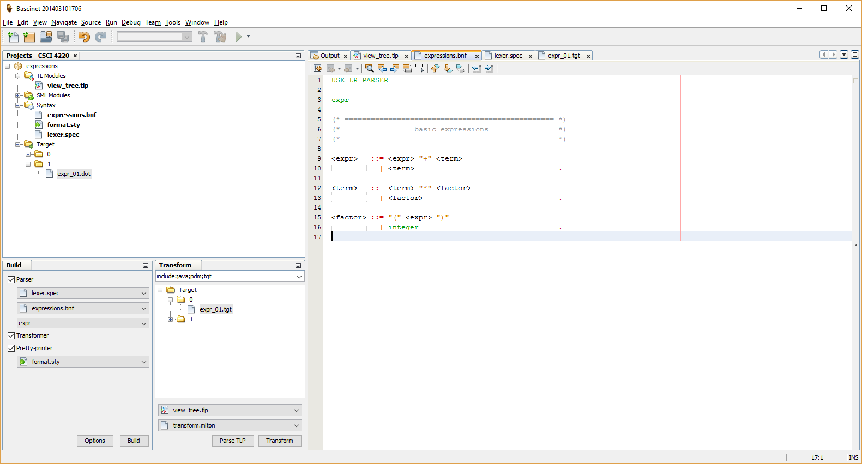

Slide 11
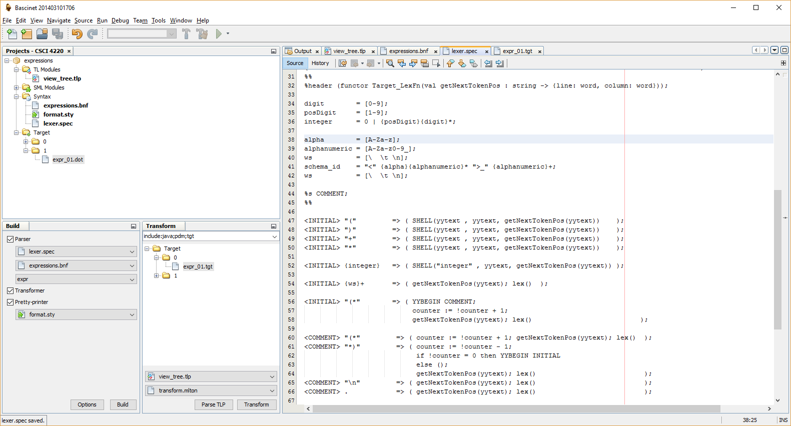

Slide 12
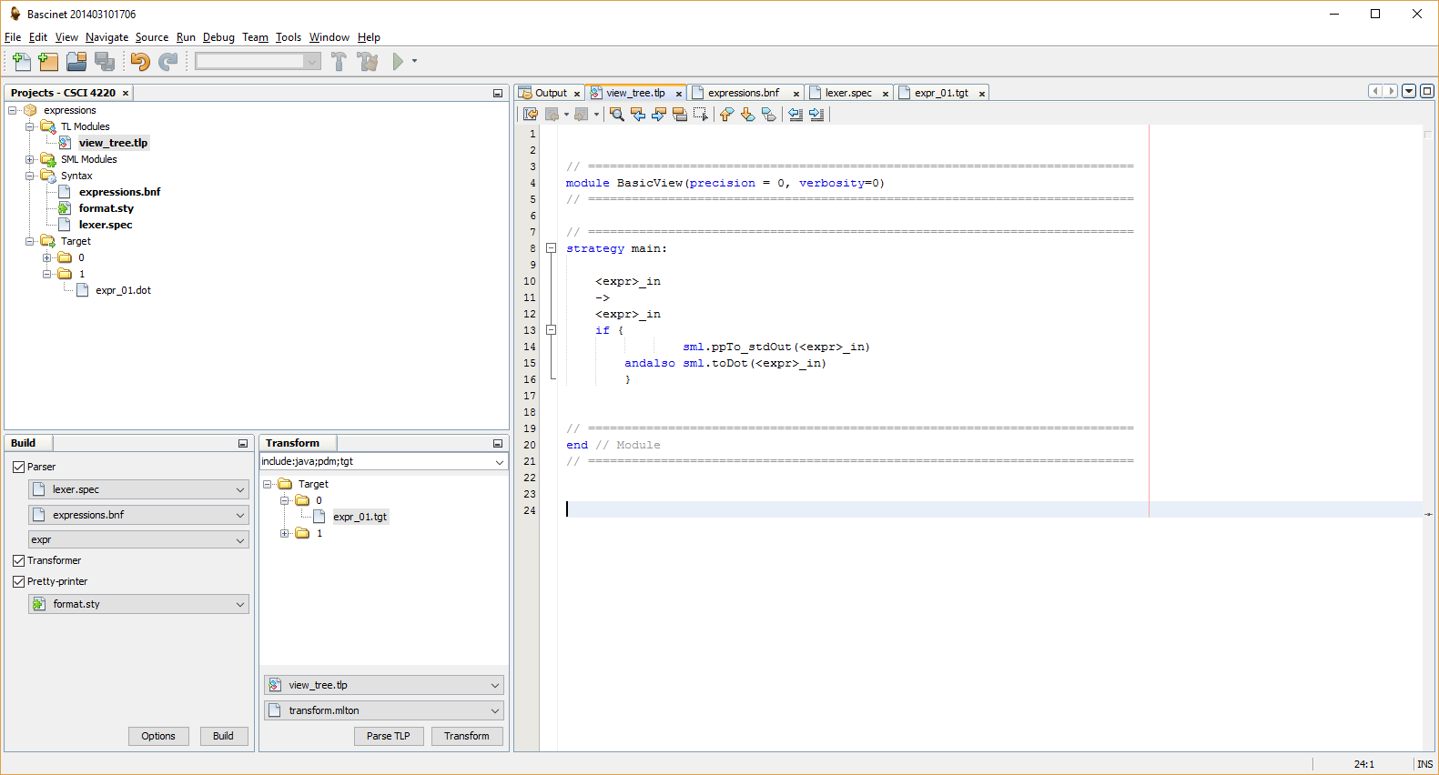

Slide 13
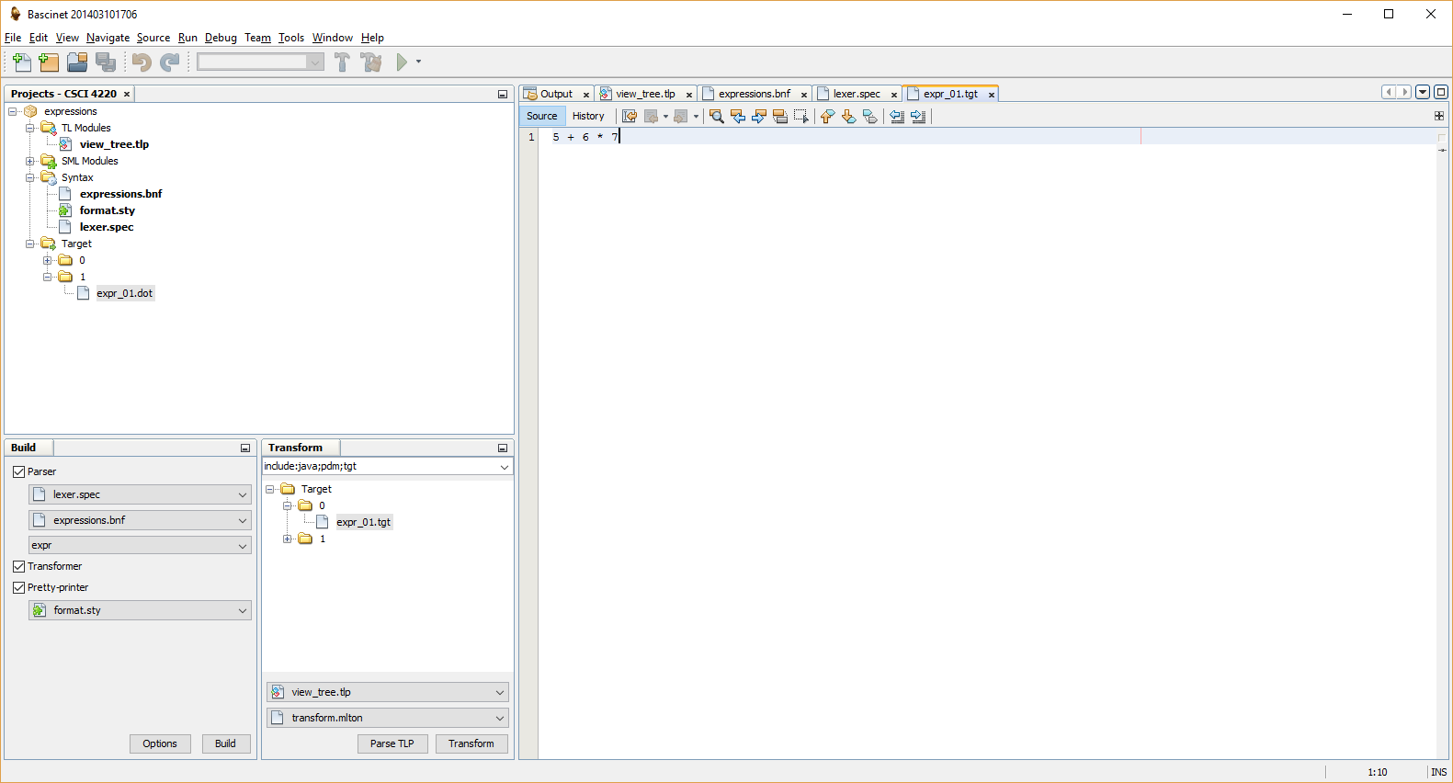

Slide 14
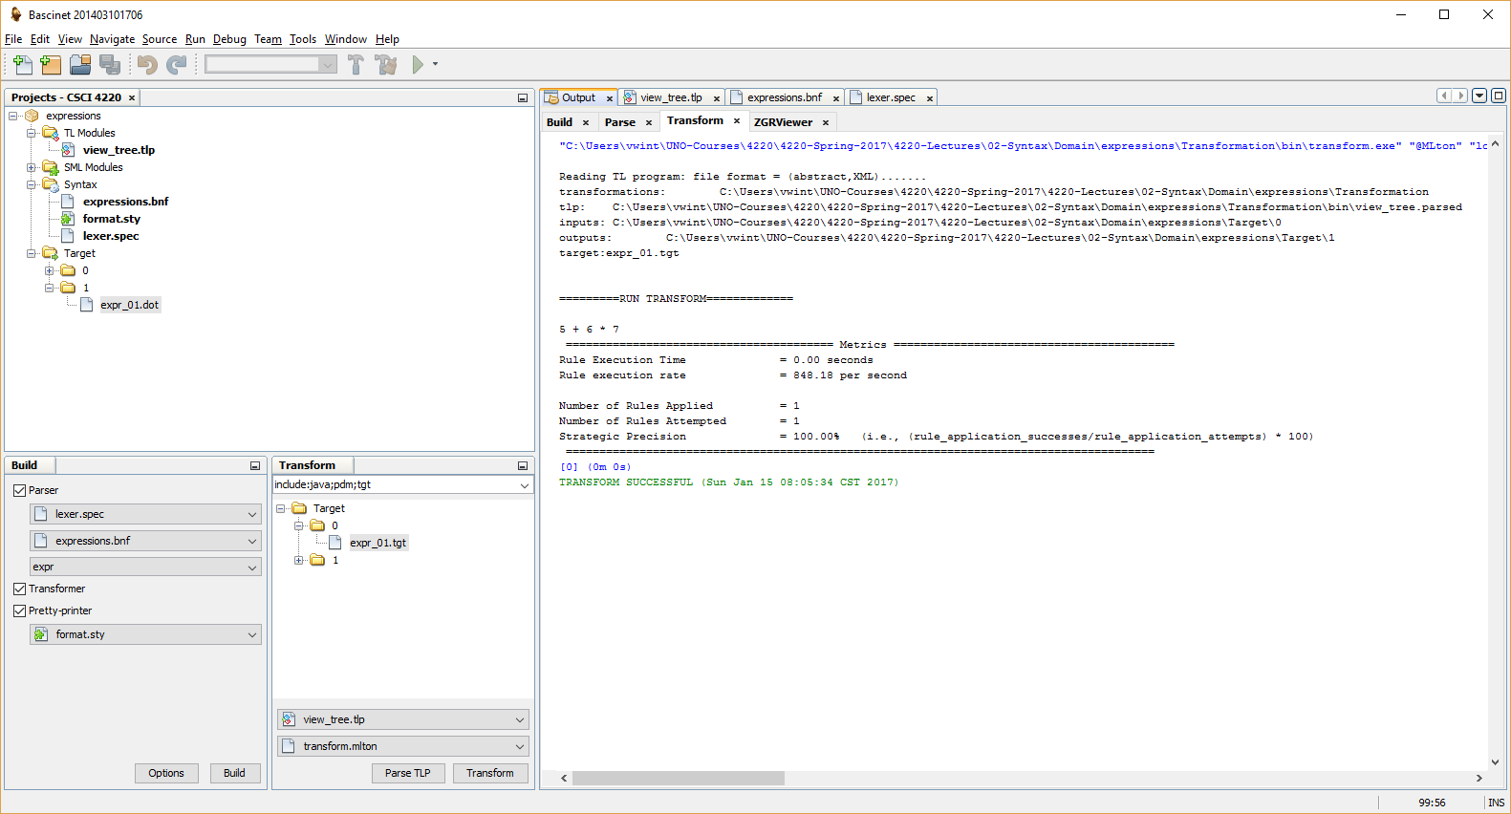

Slide 15
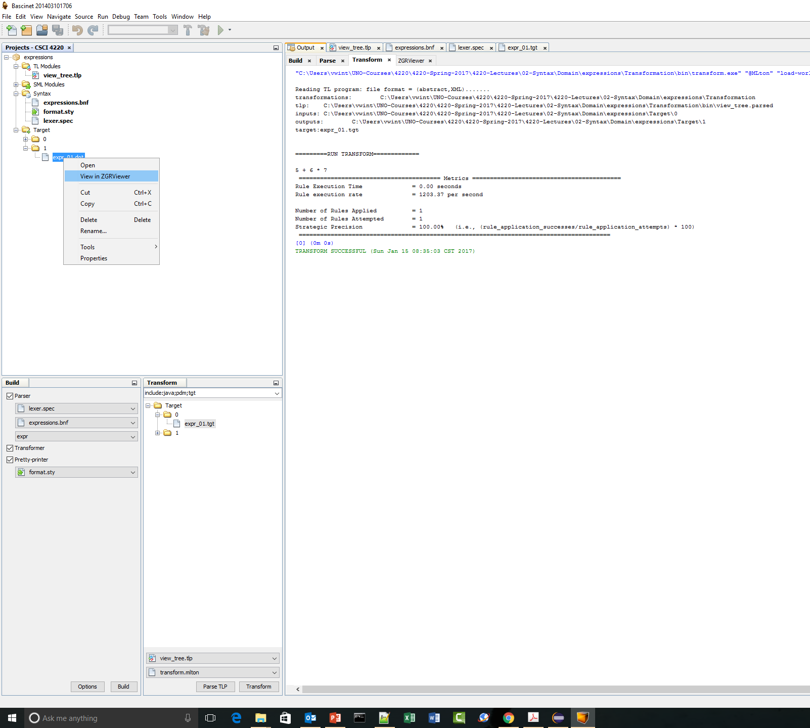

Slide 16
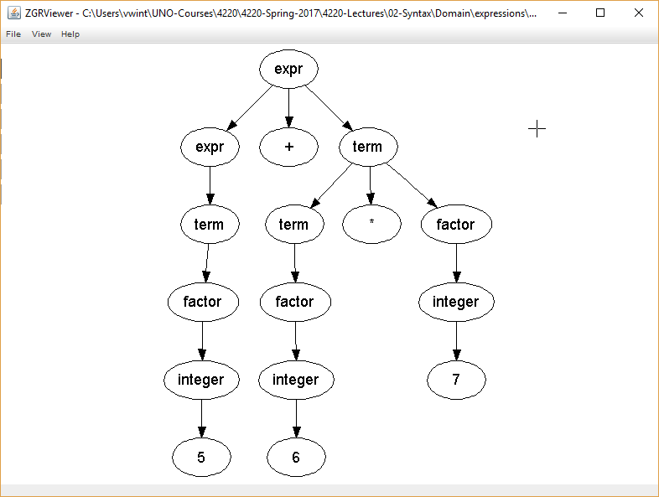

Slide 17
The End

